Slide 1
HydroFarmIoT: IoT-Integrated Hydroponic Vertical Farming System
Computer Systems Engineering
MSA University
Fall 2025
Supervisor: Dr. Ahmed Ayoub
Presented by:
Hussein Gharib Subhi 213423
Ibrahim Attia Ibrahim 210071

Slide 2
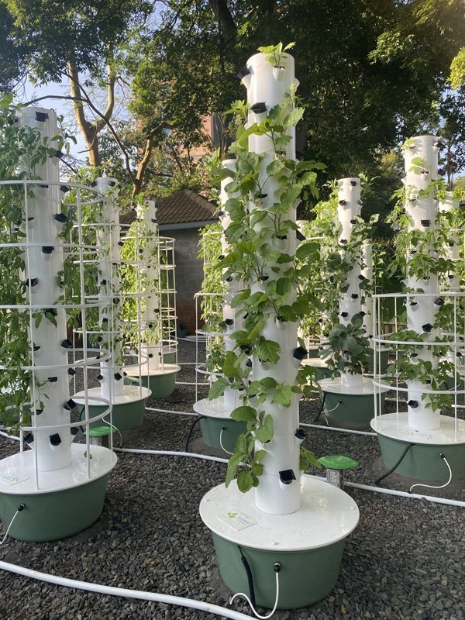
Main Topics for the presentation
Problem Definition
Aim
Project Objectives
Brief Review of Literature
Methodology
Diagram
System Specification
System Uniqueness
Cost Analysis
Timetable
Implementation progress
Plans for Improvement
Conclusions
1

Slide 3
1- Problem Definition
Global food demand is increasing due to urbanization and population growth.
Traditional farming faces challenges such as: -Limited arable land -Water scarcity -Climate dependence
Current Hydroponic systems lack automation and are labor-intensive.
2

Slide 4
2- Aim
The aim of this project is to design and implement an IoT-based hydroponic farming system capable of automating the monitoring and control of environmental conditions.
3

Slide 5
3- Project Objectives
Optimize nutrient delivery and resource utilization.
Adjust environmental parameter (e.g., pH level,TDS).
Provide real-time monitoring and control using IoT.
Ensure scalability.
4

Slide 6
4- Brief Review of Literature
Key Studies:
Optimizing Nutrient Levels with IoT
IoT- Enabled system
5

Slide 7
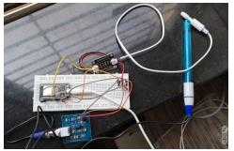
1. Optimizing Nutrient Levels with IoT
Focuses on an IoT-based hydroponic system to monitor and control key parameters.
Utilizes sensors to track pH, temperature, humidity, and light as seen in Figure 1.
Automated data collection and analysis enhance decision-making for plant growth.
Emphasizes the role of real-time monitoring in improving efficiency and sustainability.
Figure 1. pH and TDS sensors are connected to monitor nutrient levels in real time.
P. V. Kulkarni, V. Gohokar and K. Kulkarni, "Smart Hydroponic Systems: Optimizing Nutrient Levels with IoT," JES, vol. 20, no. 2, pp. 499 - 507, 2024.
6

Slide 8
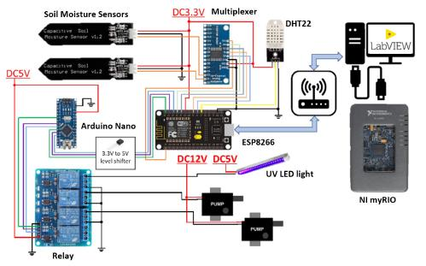
2. IoT- Enabled system
Examines vertical farming techniques augmented by IoT technologies.
Discusses sensor integration for real-time feedback on plant health as seen in Figure 2.
Highlights automation's role in achieving consistent plant yields and resource management.
Presents IoT as a key driver for smart farming scalability.
Figure 2. Detailed circuit connections of proposed system
H. T. Ng, Z. K. T. K. Tham, N. A. Abdul Rahim, A. W. Rohim, W. W. Looi and N. S. Ahmad, "IoT-enabled system for monitoring and controlling vertical farming operations," IJRES, vol. 12, no. 3, pp. 453 - 461, 2023.
7

Slide 9
5- Methodology
Approach:
Integrate sensors for real-time monitoring of pH, nutrients, water temperature, etc.
Control actuators (pumps) using a microcontroller based on sensor feedback.
Use IoT for remote monitoring and data logging.
8

Slide 10
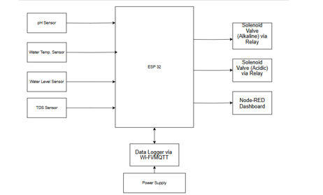
6- Diagrams (Block Diagram)
9

Slide 11
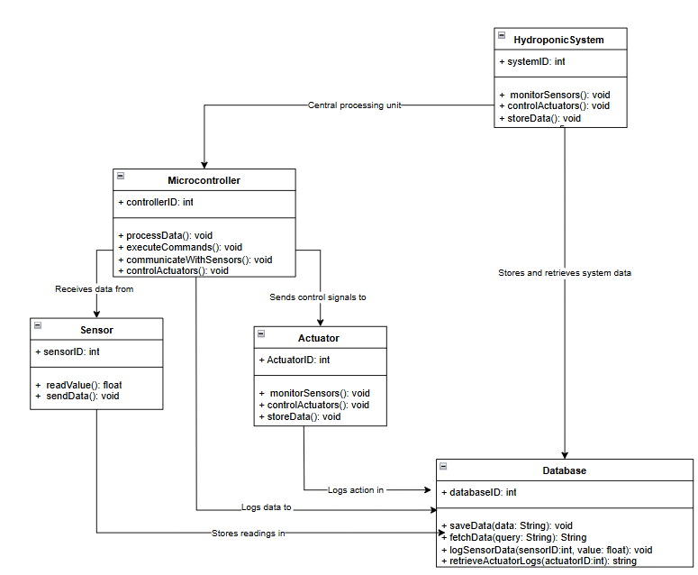
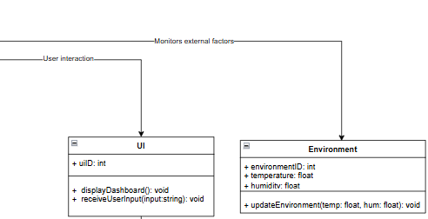
Class Diagram
10

Slide 12
7- System Specifications
Hardware:
Sensors (pH, TDS, temperature , water level ),
Actuator (pump,)
ESP32
PVC vertical pipe with 40 net pots
Tank of Nutrients 40 liter
11

Slide 13
Software:
1. Programming Language: - C++ for Arduino programming. 2. Integrated Development Environment (IDE): - Arduino IDE for writing and uploading code to the microcontroller. 3. IoT Platform: - Node-RED 4. Data Logging: - MQTT + Node-RED Logging
12

Slide 14
8- System Uniqueness
Farming Aspect:
Data Analytics Dashboard
Engineering Aspect:
Real-Time Multi-Sensor Monitoring
13

Slide 15
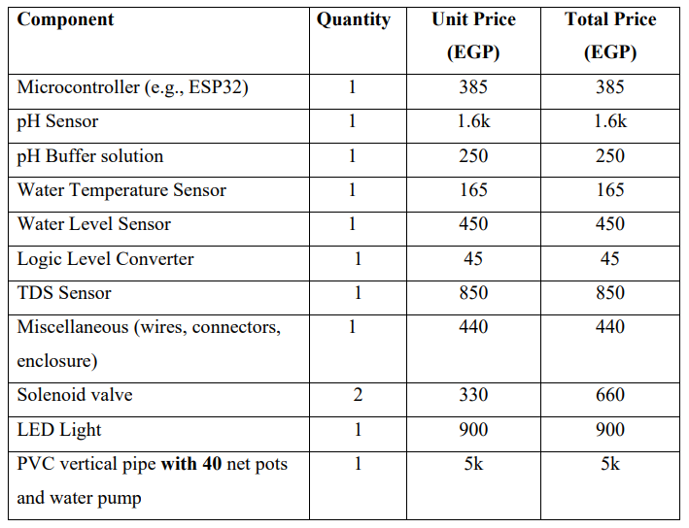
9- Cost Analysis
Prototype cost analysis in ($USD): $215
Other prototypes of the same size go for around $650.
14

Slide 16
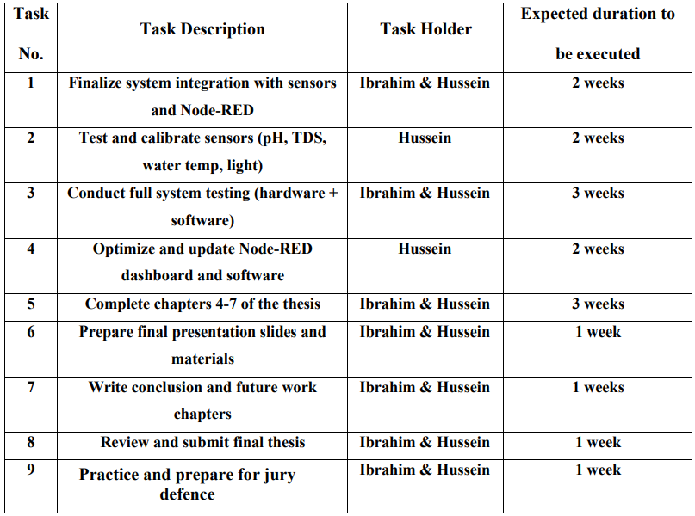
10-Timetable
The main milestones and stages of the project are illustrated in the following table
15

Slide 17
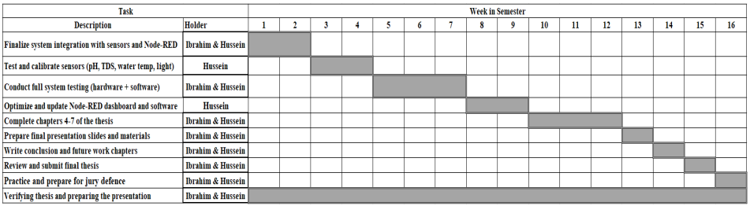
Gantt Chart
16

Slide 18
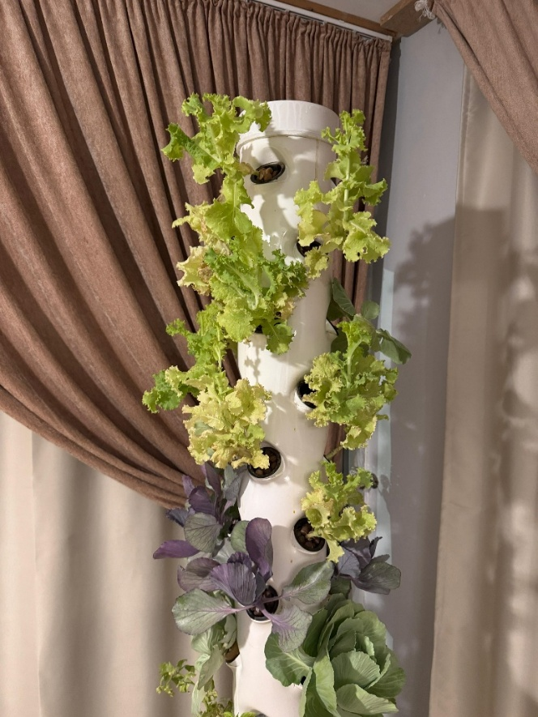
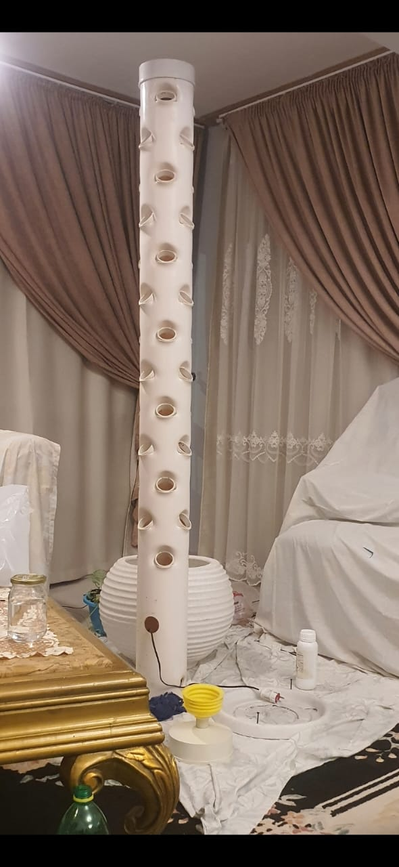
11- Implementation progress
1- Vertical pipe structure built and tested for stability and strength.
Figure 4. structure during our cycle
17
Figure 3. structure 40 net pots

Slide 19
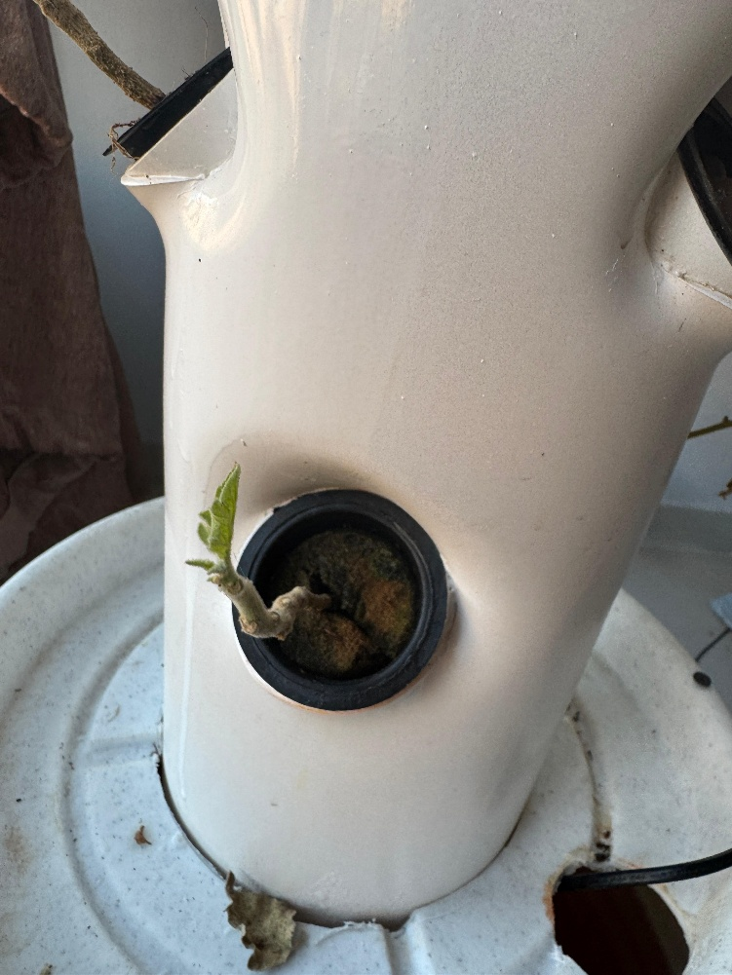
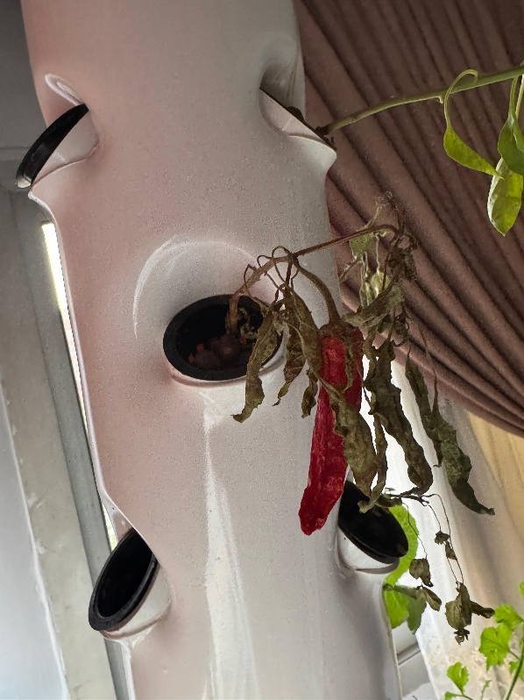
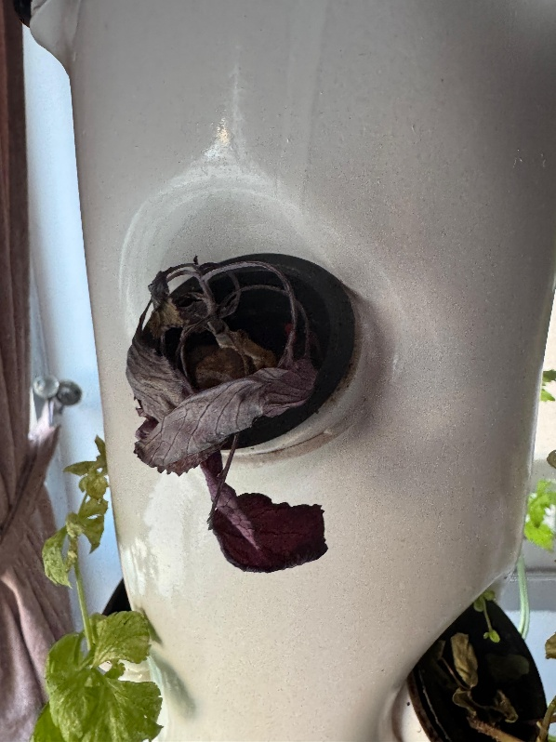
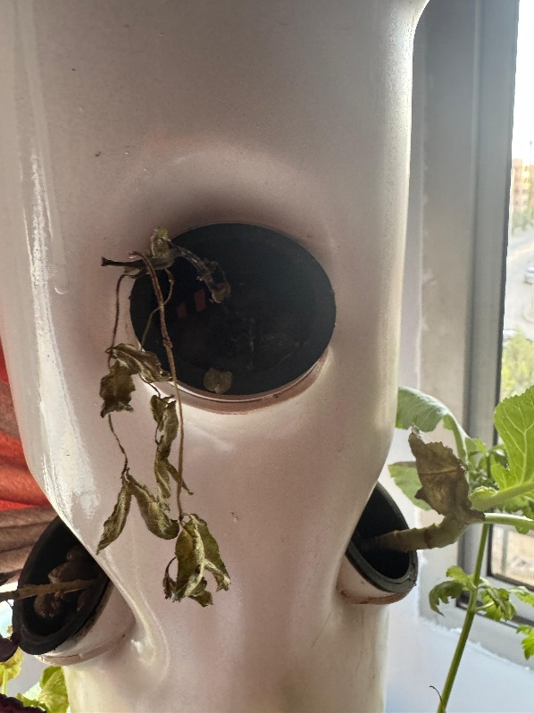
11- Implementation progress
2- Nutrient ratio error
Figure 5. Death of crops due wrong amount of PPM Range
Figure 6. Revitalize the plant after fixing the issue.
18

Slide 20
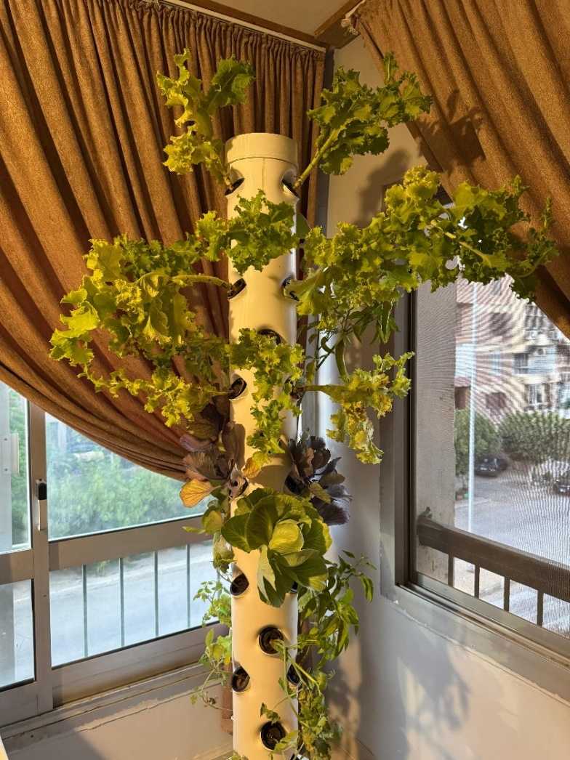
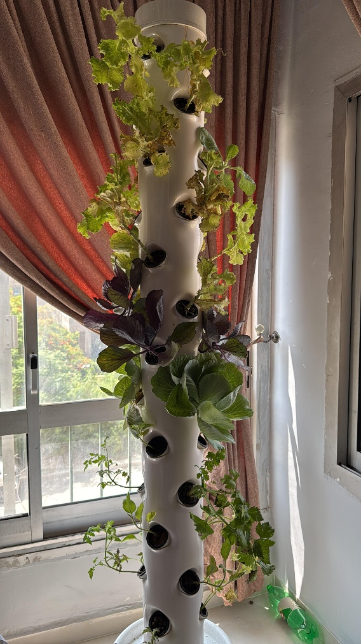
11- Implementation progress
3- Photos from the same planting cycle to observe development over time
Figure 7. Snapshot from two weeks ago
19
Figure 8. Snapshot yesterday

Slide 21
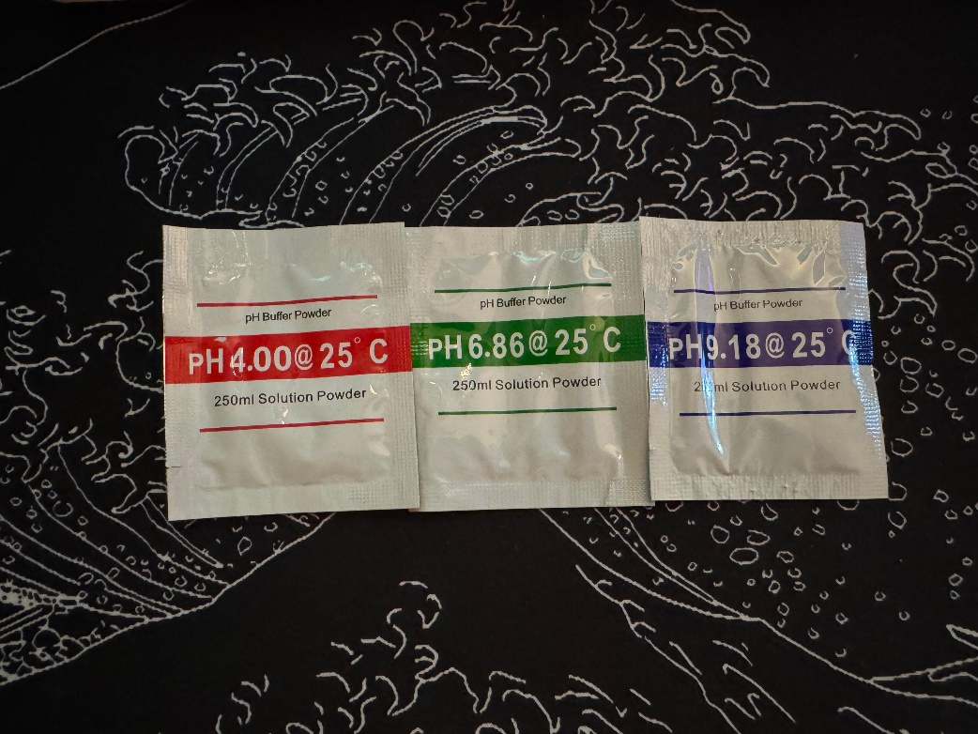
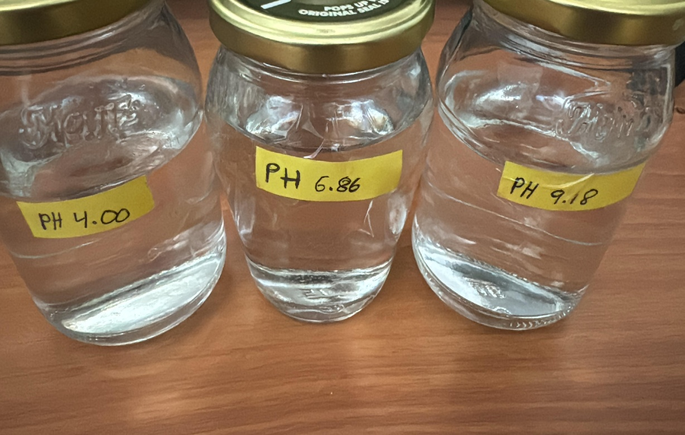
11- Implementation progress
4- PH Calibration Progress Using Ready-Made Buffers to Ensure Accurate Readings
Figure 10. Buffer solutions
20
Figure 9. Ready-Made Buffers

Slide 22
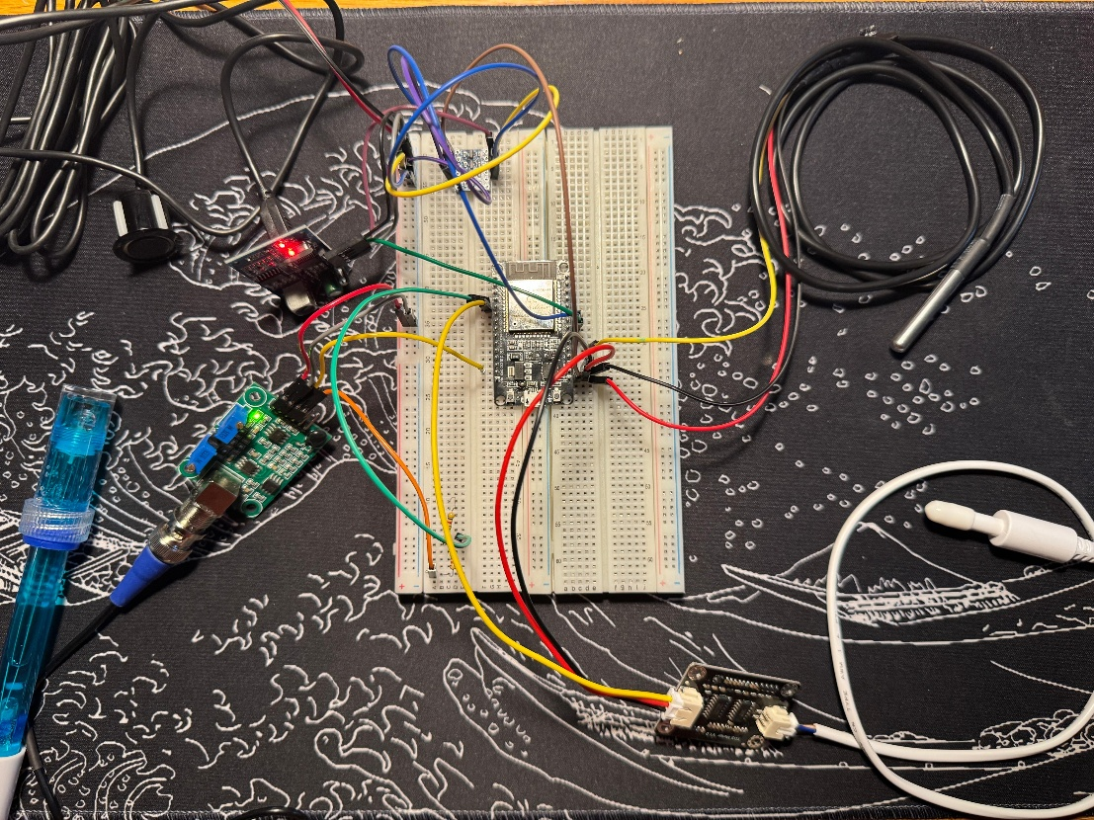
11- Implementation progress
5- Photo documenting the installation of sensors on the ESP module
Figure 11. Connections of TDS, water level, water temperature, and pH sensors
21

Slide 23
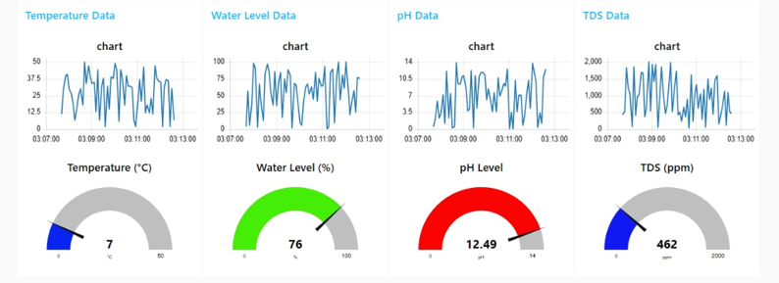
11- Implementation progress
6- The interface of the dashboard of our system
22
Figure 12. Dashboard collecting all readings

Slide 24
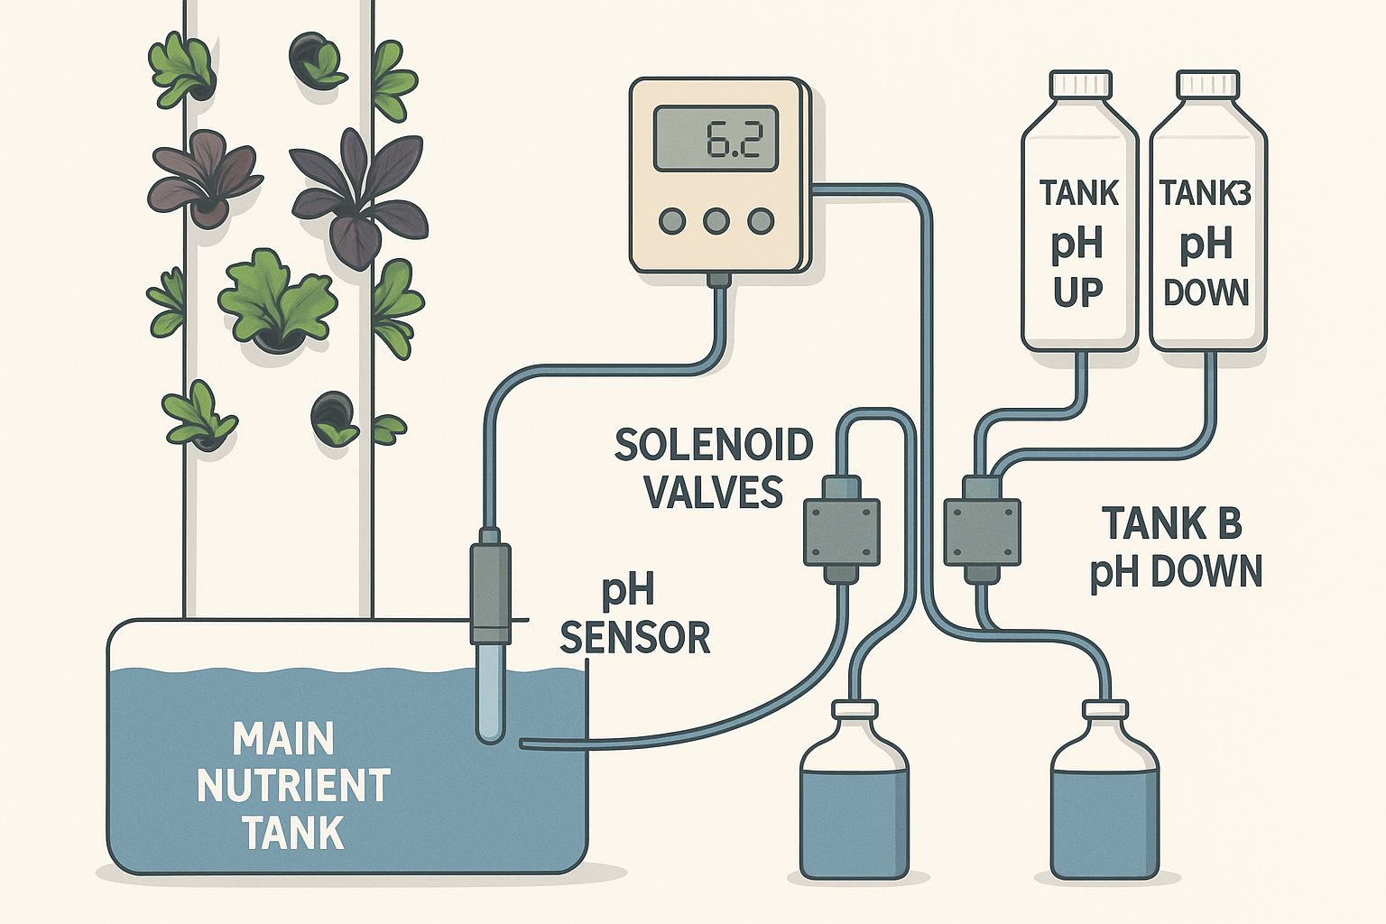
12- Plans for Improvement
1 -Automated pH Control System
-Tank A holds pH Up and Tank B holds pH down, both connected to the main nutrient tank via tubing. -Solenoid valves or peristaltic pumps control dosing based on real-time pH readings. -A microcontroller automates the process, keeping pH within the optimal range (e.g., 5.5–6.5).
Figure 13. System diagram
23

Slide 25
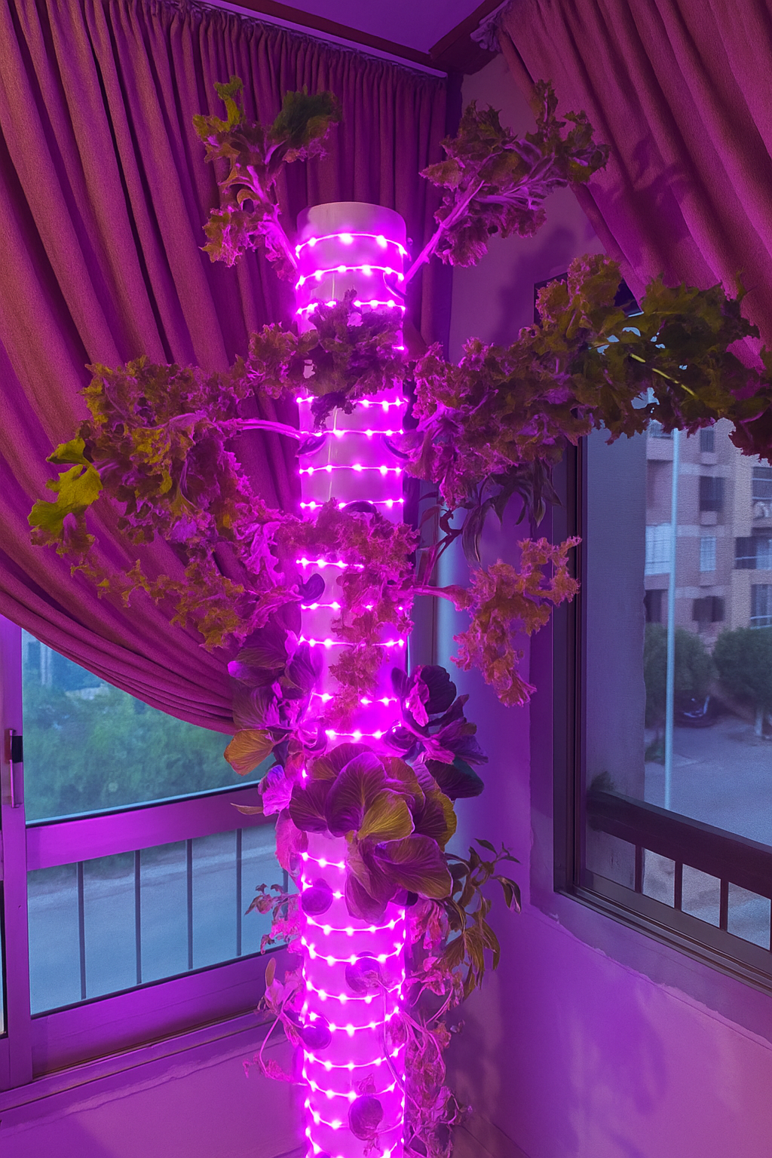
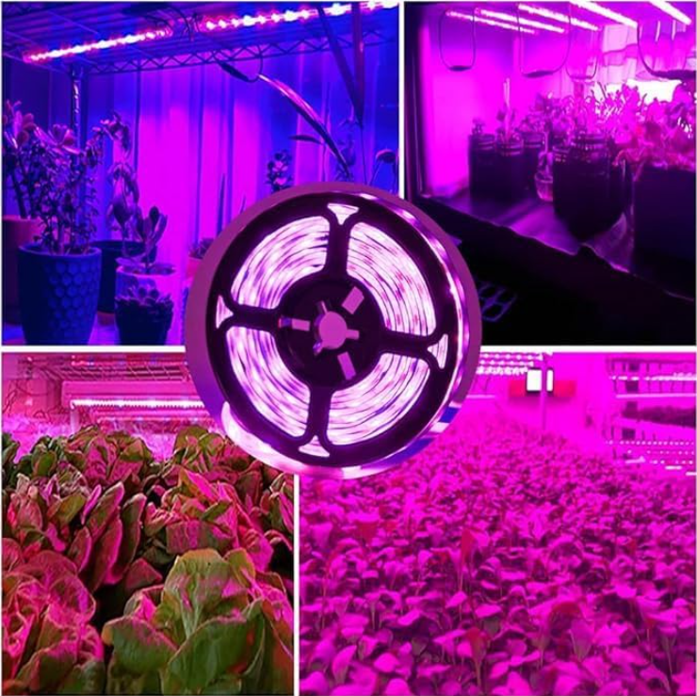
12- Plans for Improvement
2 -Use of LED Grow Lights
-Provide essential red and blue light spectrum for photosynthesis
-Replace or supplement sunlight in indoor environments
-Faster plant growth and higher yields
-Energy-efficient and low heat output
-Allows controlled light cycles for consistent development
Figure 13. led view
24

Slide 26
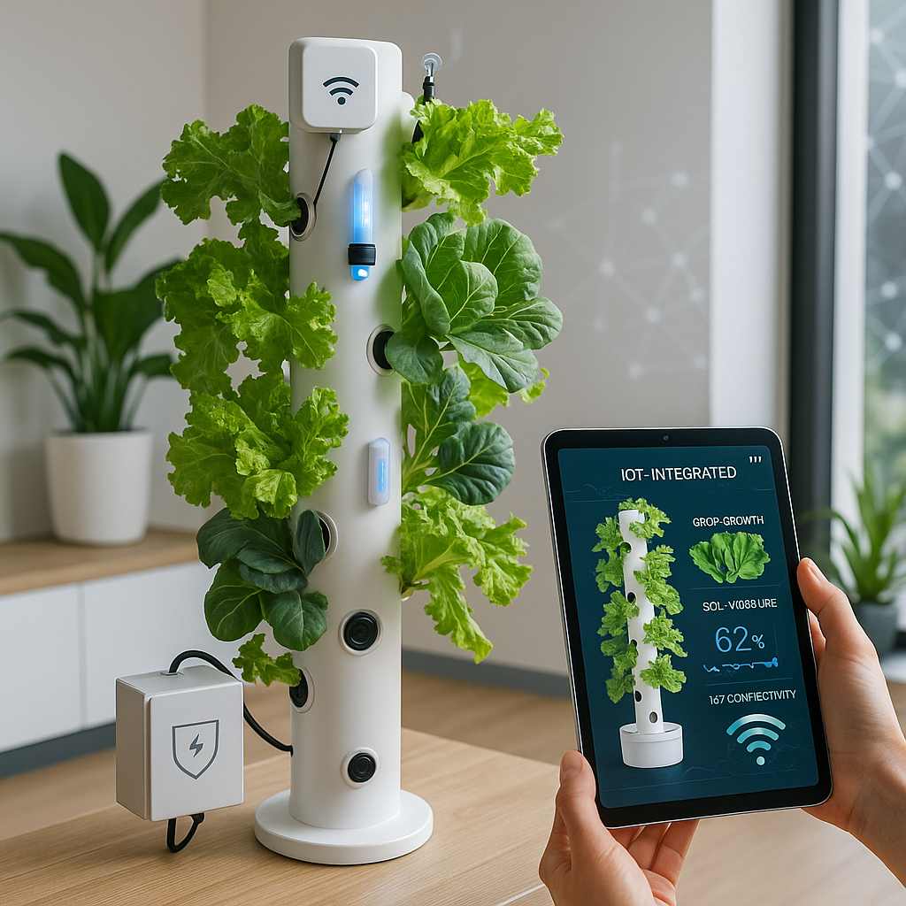
12- Plans for Improvement
3 -junction box and lcd screen
Junction Box – Key Points
-Central hub for all electrical wiring
-Organizes connections for lights, pumps, sensors
-Protects circuits from moisture, damage, waterproof
-Supports automation by housing relays or microcontrollers
LCD Screen – Key Points
-Displays real-time data (temperature, humidity, pH, etc.)
-Alerts user to errors or low nutrient/water levels
-Increases usability without external devices
Figure 14. junction box and lcd screen view
25

Slide 27
13- Conclusion
Addressed challenges of traditional farming like water scarcity and labor intensity.
Achieved automation, resource optimization, and real-time monitoring through IoT.
Delivered a cost-effective system with enhanced scalability compared to existing solutions.
26

Slide 28

Thank You

